Slide 1
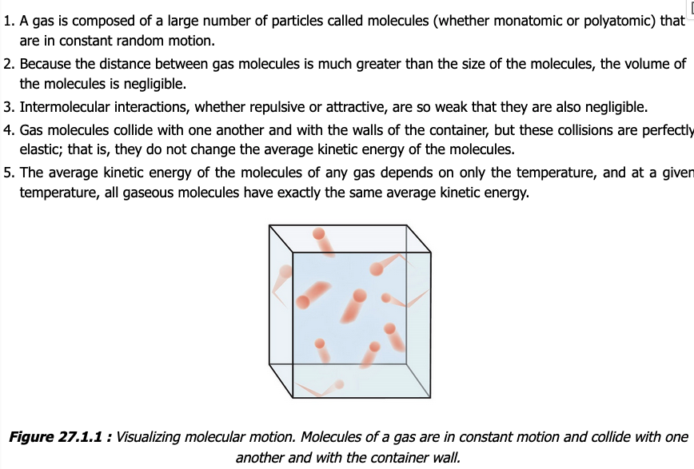
Week 3 – Assumptions of the kinetic-molecular theory of gases

Slide 2
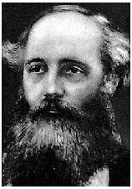

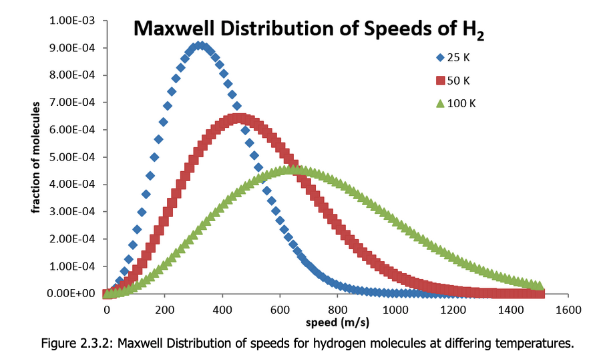




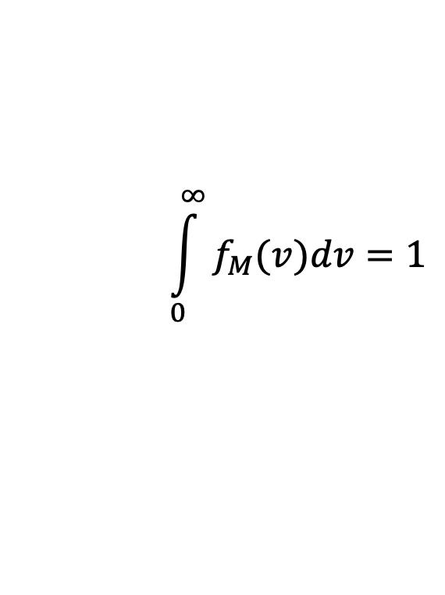
Week 3 – The Maxwell Distribution (which we’re calling “$f_{M}$”)
$$f_{M}(v)$$
isotherms of $f_{M}\left(v\right)$ for $H_{2}(g)$
$$\frac{s}{m}$$
$$\frac{m}{s}$$
$$\int_{0}^{∞}{f_{M}(v)dv}=1$$

Slide 3
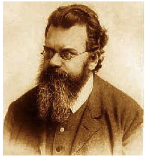
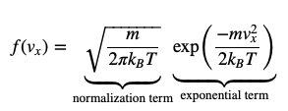
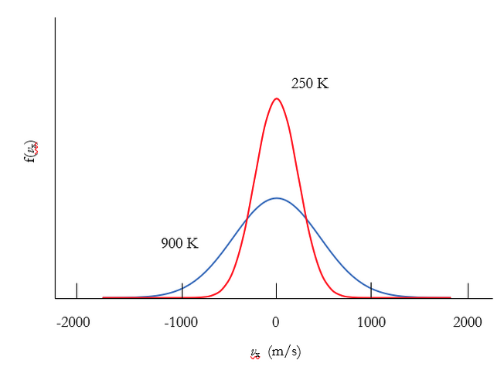

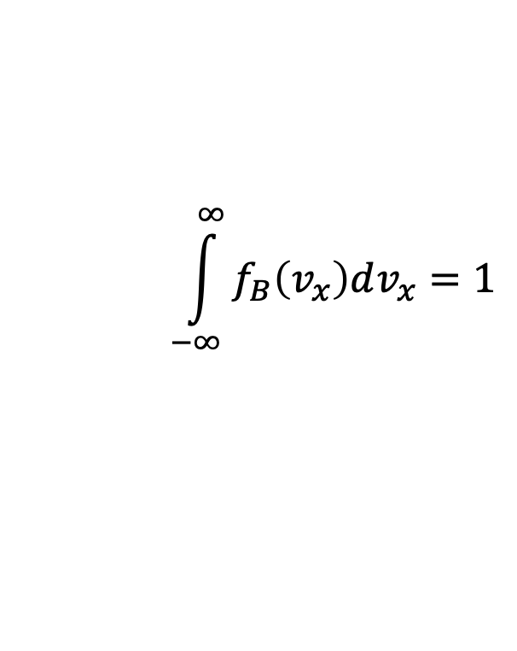



Week 3 – The Boltzmann Distribution (which we’re calling “$f_{B}$”)
$$f_{B}(v_{x})$$
isotherms of $f_{B}\left(v_{x}\right)$ for $H_{2}(g)$
$$\frac{s}{m}$$
$$\frac{m}{s}$$
$$\int_{−∞}^{∞}{f_{B}\left(v_{x}\right)dv_{x}}=1$$

Slide 4



The kind of question I might ask – Probability densities
What are the units of $f(v_{x})$?
$$v_{x} (\frac{m}{s})$$
Notes:
Week 3

Slide 5

The kind of question I might ask – Probability densities
What are the units of $f(v_{x})$?
$$(\frac{s}{m})$$
$$v_{x} (\frac{m}{s})$$
Notes:
Week 3

Slide 6
The kind of question I might ask – Probability densities
Which graph below corresponds to the lighter molecule?
$$v_{x} (\frac{m}{s})$$
Notes:
Week 3

Slide 7
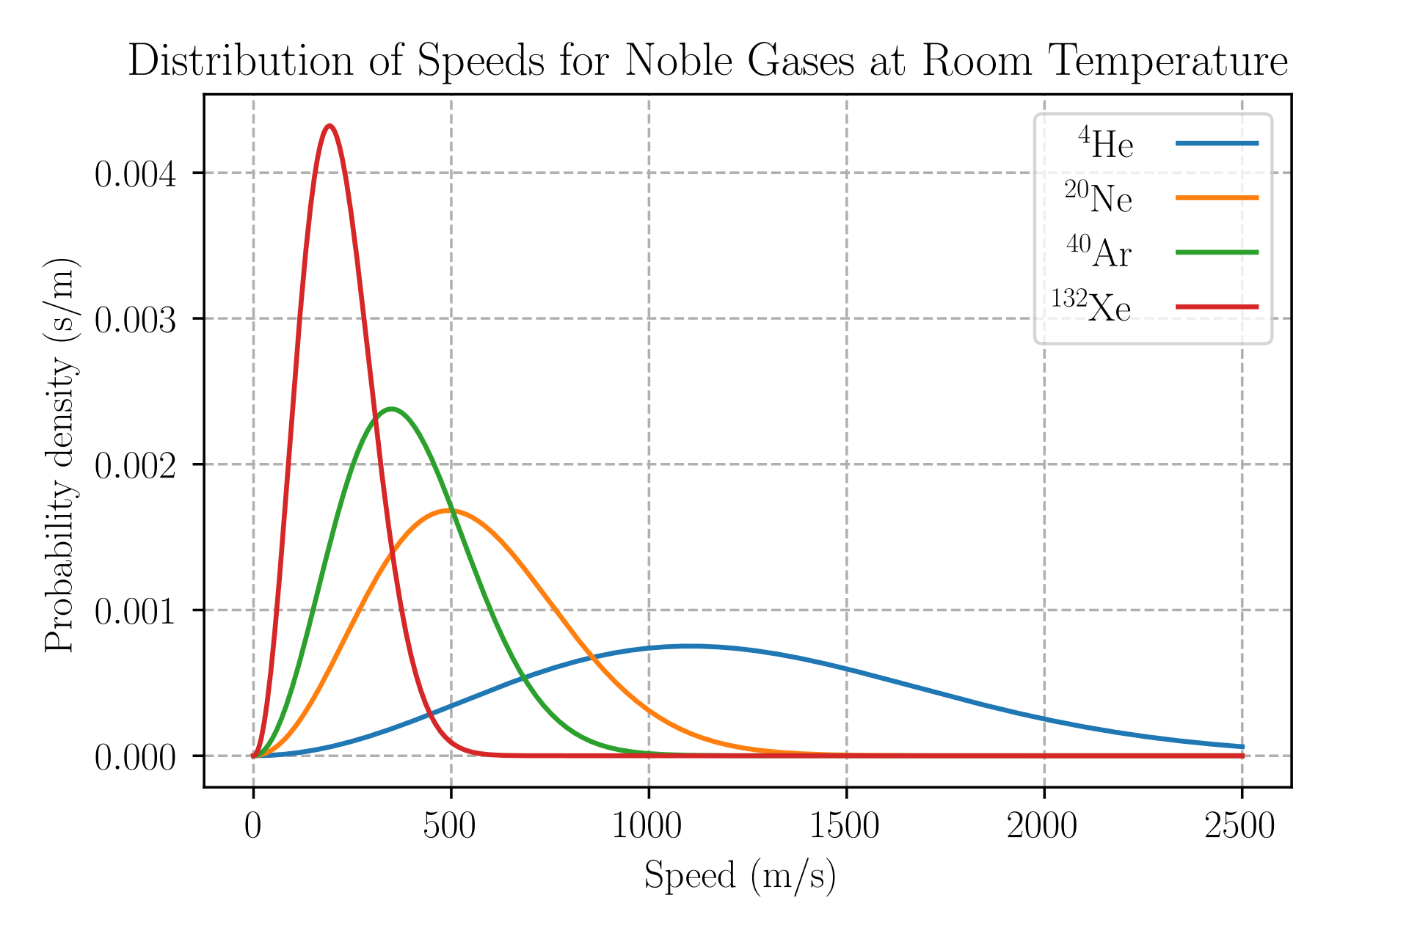

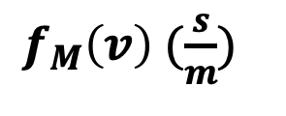
The kind of question I might ask – Probabilities from probability densities
What’s the probability (as a fraction, and also in %) of finding a Neon gas atom with speed between 740 m/s and 760 m/s?
$f_{M}\left(v\right)$ $(\frac{s}{m})$
$v (\frac{m}{s})$
Notes:
Week 3

Slide 8
The kind of question I might ask – Probabilities from probability densities
What’s the probability (as a fraction, and also in %) of finding a Neon gas atom with speed between 740 m/s and 760 m/s?
$f_{M}\left(v\right)$ $(\frac{s}{m})$
$v (\frac{m}{s})$
Notes:
Week 3

Slide 9
The kind of question I might ask – Probabilities from probability densities
What’s the probability (as a fraction, and also in %) of finding a Neon gas atom with speed between 740 m/s and 760 m/s?
$f_{M}\left(v\right)$ $(\frac{s}{m})$
Width = 20 m/s
Height = 0.001 s/m
Probability = 0.02 (2%)
$v (\frac{m}{s})$
Notes:
Week 3

Slide 10
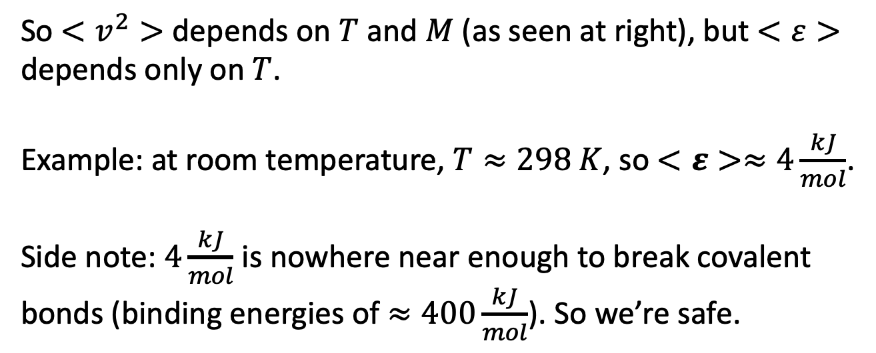

Week 3 – The average kinetic energy depends only on the temperature (not the mass)
We saw that $<v^{2}> =\frac{3RT}{M}$, while the average kinetic energy of a mole of gas molecules is
$$<ε>{=N}_{A}<\frac{1}{2}mv^{2}> =\frac{1}{2}M\frac{3RT}{M}=\frac{3}{2}RT$$
So $<v^{2}>$ depends on $T$ and $M$ (as seen at right), but $<ε>$ depends only on $T$.
Example: at room temperature, $T≈298 K$, so $<ε>≈4\frac{kJ}{mol}$.
Side note: $4\frac{kJ}{mol}$ is nowhere near enough to break covalent bonds (binding energies of $≈400\frac{kJ}{mol}$). So we’re safe.

Slide 11

The kind of question I might ask – Analytical moments of the speed
Which Gaussian integral below would you use to find $<v^{2}>$?
$$f_{M}=N_{M}v^{2}\exp\left(−Dv^{2}\right)$$
Notes:
Week 3

Slide 12
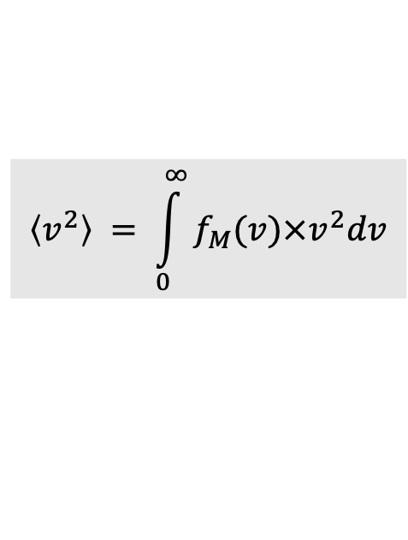
The kind of question I might ask – Analytical moments of the speed
Which Gaussian integral below would you use to find $<v^{2}>$?
$$f_{M}=N_{M}v^{2}\exp\left(−Dv^{2}\right)$$
$$\left\langle v^{2}\right\rangle = \int_{0}^{∞}{f_{M}(v)×v^{2}dv}$$
Notes:
Week 3

Slide 13
The kind of question I might ask – Analytical moments of the speed
Which Gaussian integral below would you use to find $<v^{2}>$?
$$f_{M}=N_{M}v^{2}\exp\left(−Dv^{2}\right)$$
$$\left\langle v^{2}\right\rangle = \int_{0}^{∞}{f_{M}(v)×v^{2}dv}$$
Notes:
Week 3

Slide 14
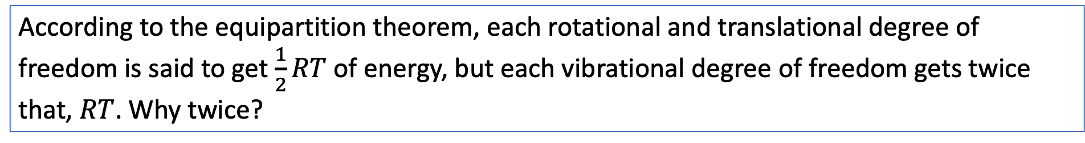
The kind of question I might ask – Equipartition
According to the equipartition theorem, each rotational and translational degree of freedom is said to get $\frac{1}{2}RT$ of energy, but each vibrational degree of freedom gets twice that, $RT$. Why twice?
Notes:
Week 4

Slide 15

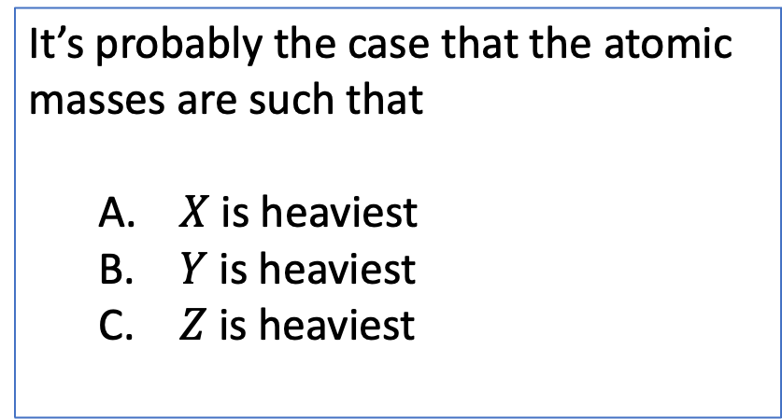
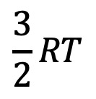


The kind of question I might ask – Relationship between vibrational energy gap and mass
These are vibrational energy levels of some diatomic molecules
It’s probably the case that the atomic masses are such that
$X$ is heaviest
$Y$ is heaviest
$Z$ is heaviest
$$\frac{3}{2}RT$$
$$X_{2}$$
$$Y_{2}$$
$$Z_{2}$$
Notes:
Week 4

Slide 16
The kind of question I might ask – Relationship between vibrational energy gap and mass
These are vibrational energy levels of some diatomic molecules
It’s probably the case that the atomic masses are such that
$X$ is heaviest
$Y$ is heaviest
$Z$ is heaviest
$$\frac{3}{2}RT$$
$$X_{2}$$
$$Y_{2}$$
$$Z_{2}$$
Notes:
Week 4

Slide 17

The kind of question I might ask – Heat capacities
These are vibrational energy levels of some diatomic molecules
What’ the heat capacity ($C_{V}$) of $n$ moles of $Y_{2}$ at this temperature?
$$\frac{3}{2}RT$$
$$X_{2}$$
$$Y_{2}$$
$$Z_{2}$$
Notes:
Week 4

Slide 18

The kind of question I might ask – Heat capacities
These are vibrational energy levels of some diatomic molecules
What’ the heat capacity ($C_{V}$) of $n$ moles of $Y_{2}$ at this temperature?
$$C_{V}=nR$$
$$\frac{3}{2}RT$$
$$X_{2}$$
$$Y_{2}$$
$$Z_{2}$$
Notes:
Week 4

Slide 19
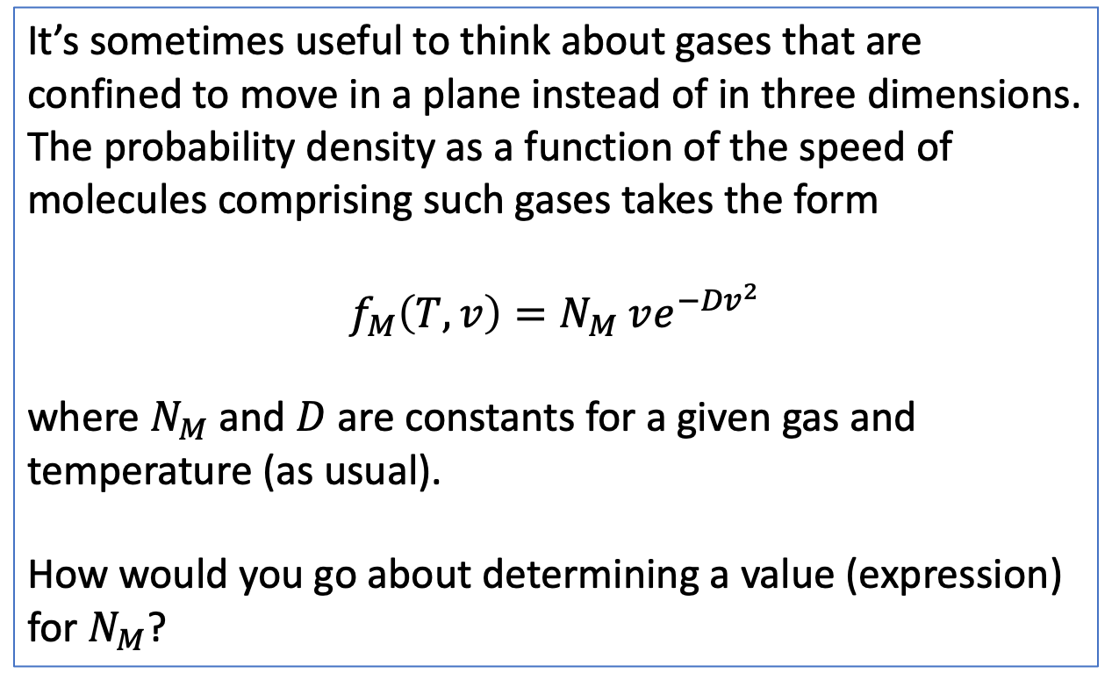
The kind of question I might ask – Normalization of a speed probability density
It’s sometimes useful to think about gases that are confined to move in a plane instead of in three dimensions. The probability density as a function of the speed of molecules comprising such gases takes the form
$$f_{M}\left(T,v\right)=N_{M} ve^{−{Dv}^{2}}$$
where $N_{M}$and $D$ are constants for a given gas and temperature (as usual).
How would you go about determining a value (expression) for $N_{M}$?
Notes:
Week 4

Slide 20
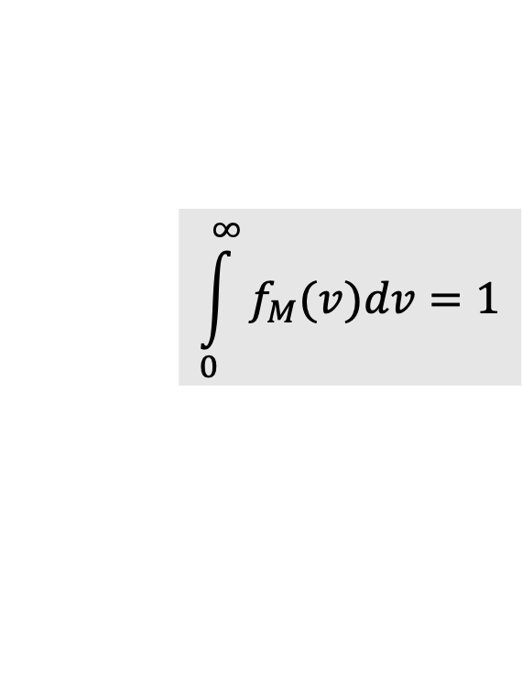
The kind of question I might ask – Normalization of a speed probability density
It’s sometimes useful to think about gases that are confined to move in a plane instead of in three dimensions. The probability density as a function of the speed of molecules comprising such gases takes the form
$$f_{M}\left(T,v\right)=N_{M} ve^{−{Dv}^{2}}$$
where $N_{M}$and $D$ are constants for a given gas and temperature (as usual).
How would you go about determining a value (expression) for $N_{M}$?
$$\int_{0}^{∞}{f_{M}(v)dv}=1$$
Notes:
Week 4

Slide 21

The kind of question I might ask – Normalization of a speed probability density
Which Gaussian integral below would you use to find $N_{M}$?
$$f_{M}=N_{M}v\exp\left(−Dv^{2}\right)$$
Notes:
Week 3

Slide 22
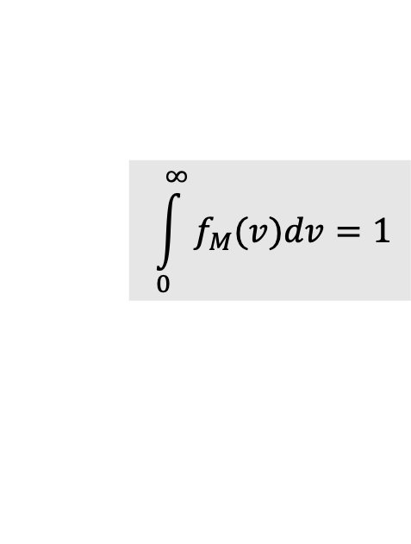
The kind of question I might ask – Normalization of a speed probability density
Which Gaussian integral below would you use to find $N_{M}$?
$$f_{M}=N_{M}v\exp\left(−Dv^{2}\right)$$
$$\int_{0}^{∞}{f_{M}(v)dv}=1$$
Notes:
Week 3

Slide 23
The kind of question I might ask – Normalization of a speed probability density
Which Gaussian integral below would you use to find $N_{M}$?
$$f_{M}=N_{M}v\exp\left(−Dv^{2}\right)$$
$$\int_{0}^{∞}{f_{M}(v)dv}=1$$
Notes:
Week 3

